Slide 1
LECTURE - 9
RANDOM

Slide 2

IDENTIFY.

Slide 3
PROBLEM 1
Nth FIBONACCI number

Slide 4
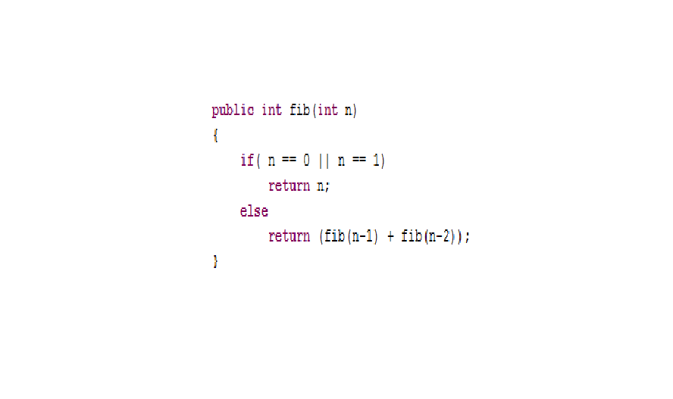
WITHOUT DP

Slide 5
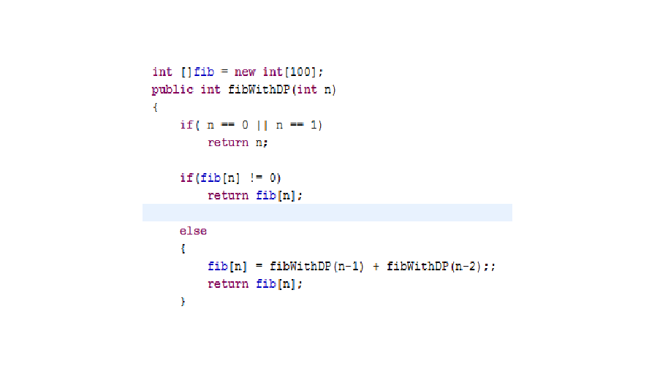
WITH DP

Slide 6
GOODIE QUESTION 2:
Why do Chameleons change color?

Slide 7
PROBLEM 2
‘N’ steps in a staircase
You can hop 1,2 or 3 steps at a time
How many ways are there to climb the stairs ???

Slide 8
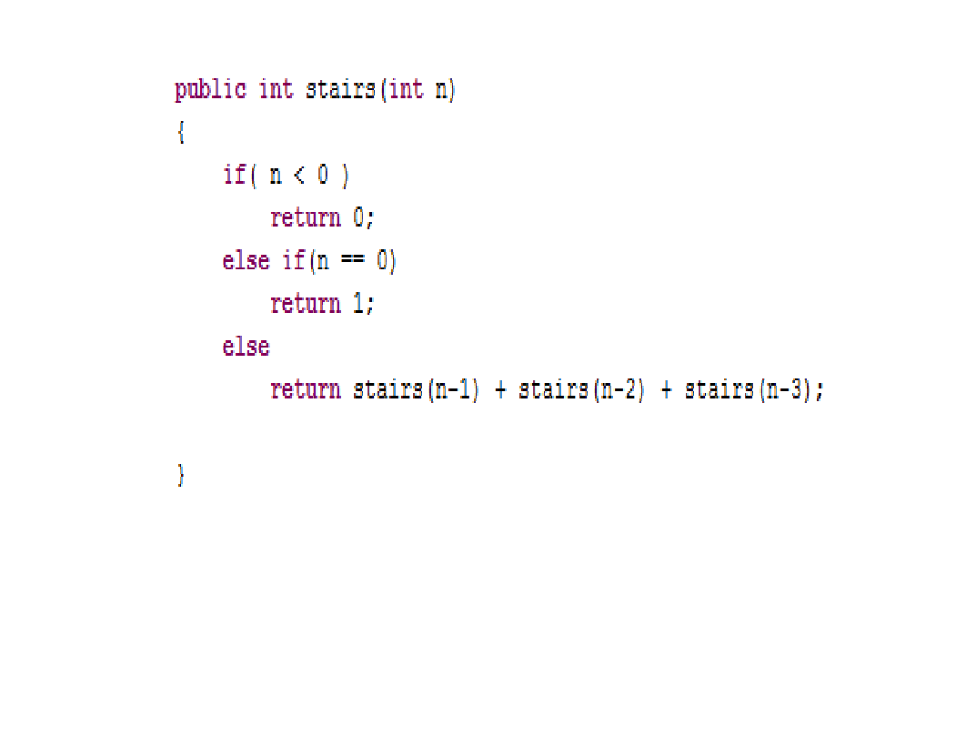

Slide 9
GOODIE QUESTION 3:
Which theory explains the origin of our Universe ?
Big Bang or Steady State ?

Slide 10
PROBLEM 3
Find Magic Index(A[i] = i) in A Sorted Array WITH :
a)Distinct Integers
b)Non-Distinct Integers

Slide 11
DISTINCT INTEGERS
Similar To Binary Search

Slide 12
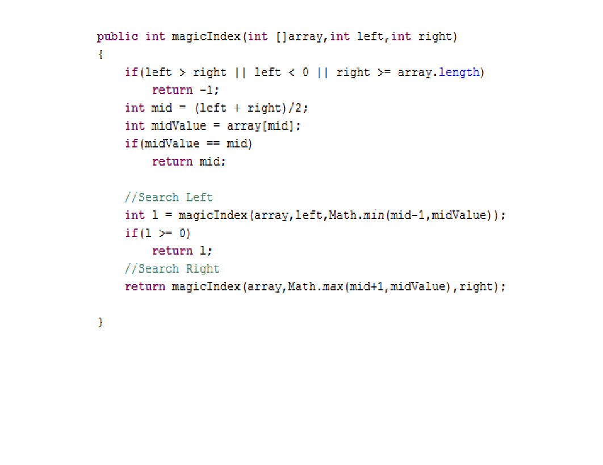
NON-DISTINCT

Slide 13

GOODIE QUESTION 4

Slide 14
PROBLEM 4
Print all subsets of a given set

Slide 15
SOLUTION 1
RECURSION

Slide 16
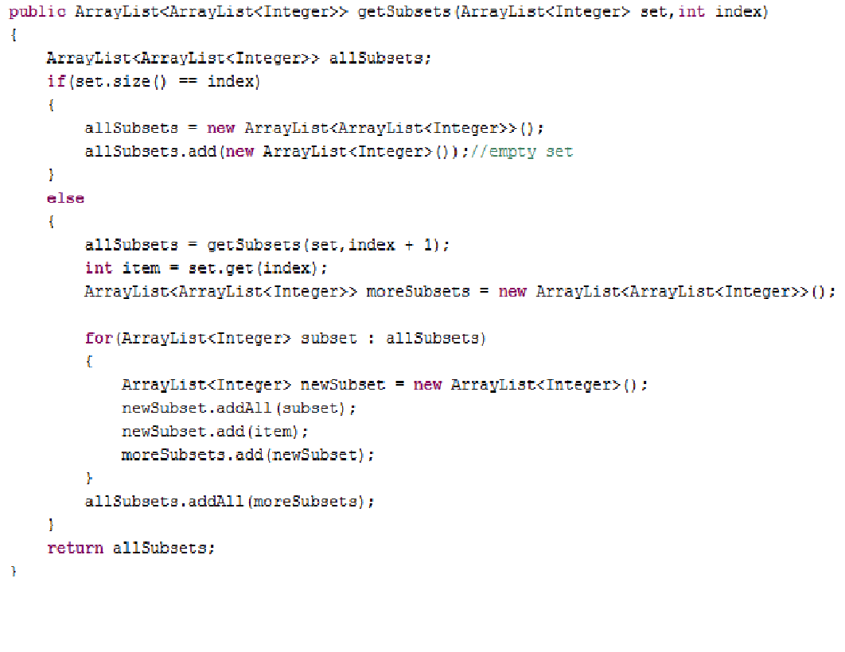

Slide 17
SOLUTION 2
COMBINATORICS

Slide 18
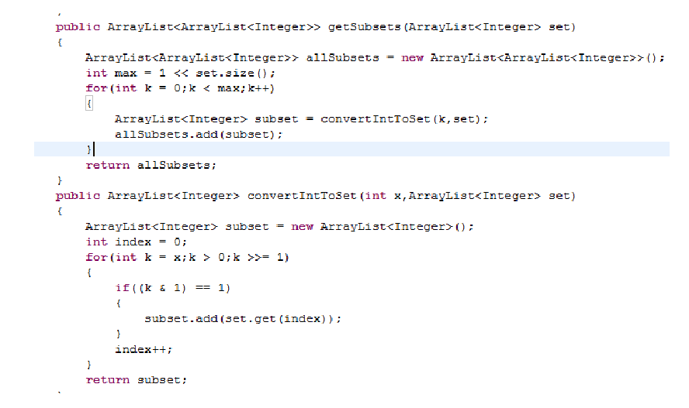

Slide 19
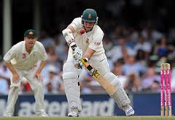
GOODIE QUESTION 5

Slide 20
PROBLEM 5
Compute all permutations of a String

Slide 21
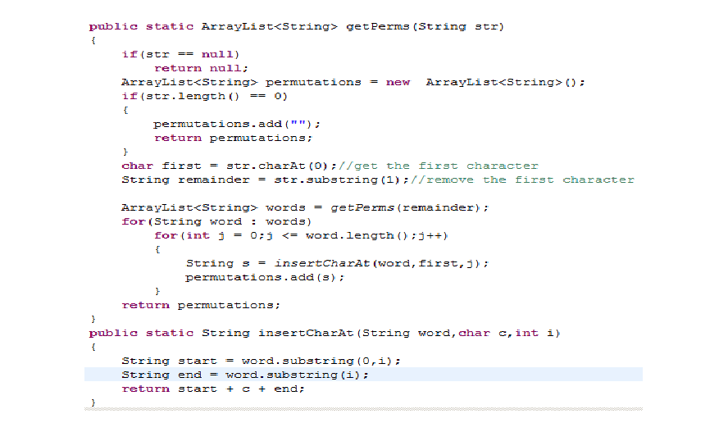

Slide 22
Goodie Question 6:
Why is Facebook themed blue ?

Slide 23
PROBLEM 6:
Denominations

Slide 24
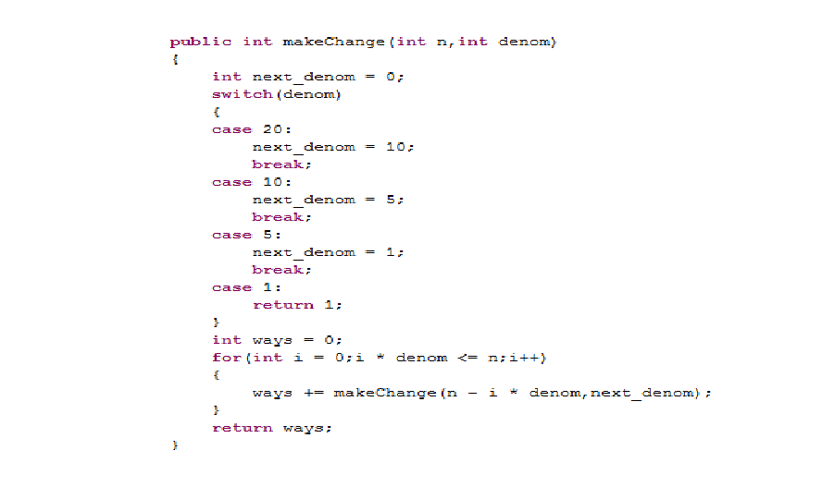

Slide 25

Goodie Question 7

Slide 26
FINAL BRAIN TEASER:
Monty Hall Problem

